Slide 1
Learn Upgrade
Speaker name
Title
Microsoft corporation

Slide 2
Upgrade Cycle
Learn
Prepare
Test
Implement
Validate
Upgrade methods
Document environment
Build test farms
Build/upgrade farms
Troubleshooting
Downtime mitigation
Manage customizations
Plan upgrade strategy
Make items upgradable
Use real data
Evaluate techniques
Find issues early
Deploy customizations
Minimize downtime
Monitor progress
UI/UX issues
Data issues
New capabilities
Upgrade event failures

Slide 3
Learn Upgrade
Upgrade Requirements

Slide 4
Server Prerequisites
2010 or earlier SharePoint products must not be installed
Existing content databases must be at 2010 RTM or later
If using RBS, content databases should be upgraded to 2010 SP1 or later *
To use existing 2010 SharePoint Farm hardware:
Backup your farm using SharePoint backup tool
Ensure your backup of farm and databases
Ensure SharePoint 2010 or earlier is not installed
Either uninstall old products
Including dependent products like Project Server and language packs
Or reinstall the operating system (recommended)

Slide 5
Client Minimum Software Requirements
Office 2010 or Office 2013
For full offline and integrated experience
SharePoint Designer 2010 only partially works for 14 mode sites
Planned to be blocked in a future update for the client
SharePoint Designer 2013 works for both 14 and 15 mode sites
SharePoint Workspace 2010 will work for both 14 mode sites
SkyDrive Pro will work with 15 mode sites
Web Browser
Internet Explorer 8 or higher *

Slide 6
Learn Upgrade
Upgrade Methods/Supported Upgrade Paths

Slide 7
Upgrade Methods
Database Attach Upgrade
Only available method for version to version (V2V) upgrades
Works for both version to version (V2V) and build to build (B2B) upgrades
Works for content and services databases
In-Place Farm Upgrade
Only available for build to build (B2B) upgrades

Slide 8
Databases Supporting Database Attach Upgrade
Content databases
Project databases
Note: Four 2010 merged to one during upgrade
Search admin database
Profile database
Social database
Managed Metadata database
Secure Store database
Note: Passphrase required to retain passwords in store
Access databases
Note: Supported for B2B upgrades only

Slide 9
Databases Not Supporting Database Attach Upgrade
Configuration database
Unsupported for both V2V and B2B upgrades
Has never been supported in prior versions
Search index databases
Unsupported for V2V upgrades only
Sync database
Unsupported for V2V upgrades only

Slide 10
Authentication Mode Support & Upgrade
Windows Classic Support (Legacy)
SP2013 supports this with some issues
Windows Claims Support
2010 supports this with a few exceptions
Outlined in claims migration document
Migration before upgrade recommended
Forms Auth Support
No changes from 2010
Ensure provider installed with same name before database attachment
Database to Web Application authentication mode mismatches
Database attach in SP2013 detects mismatched auth support
Test-SPContentDatabase in SP2013 also detects this
Fix before attaching is best advice

Slide 11
Claims Migration Best Practices WRT Upgrade
Should not group both events together
Prevent stacked faults that could confuse troubleshooting
Ideally migrate to claims before upgrade
Alternately do so after upgrade is completed and verified successful
Find authentication mode mismatch issues between content databases and web applications with Test-SPContentDatabase first
If partial migration within content database, solve that before continuing
If misconfigured web application, fix before doing database attach/upgrades
Ensure all external data source/web services work as expected after claims migration

Slide 12
Learn Upgrade
Upgrade Improvements

Slide 13
Upgrade Improvements Overview
Deferred Site Collection Upgrade
Site Collection Health Checks
Upgrade Evaluation Site Collections
System Event Notifications System
Logging Changes
Site Collection Upgrade Throttling
Federated Services Compatibility Cross Versions

Slide 14
Deferred Site Collection Upgrade
Allows existing 2010 site collections to work unchanged in SP2013
No SharePoint 2010 installation required
SP2013 has all required SharePoint 2010 files included
Replaces Visual Upgrade
Spiritual successor
Safer process
Requires deep backwards compatibility
All 14 features side by side with 15 ones
Existing customizations should just work
Default state for all site collections in upgraded databases
Cannot be forced automatically on database upgrade

Slide 15
Site Collection Health Checks
Rule based health checks
Looks for common known issues:
Blocking upgrade issues
Missing SP2013 templates
Post upgrade issues
Un-ghosted files
Site collection level scoped tool
UI exists for Site Collection Admins
PowerShell cmdlet for Farm Admins
Runs automatically before Site Collection version to version upgrade
Prevents upgrade if blocking issues detected
Does not run before any build to build upgrades

Slide 16
Upgrade Evaluation Site Collections
Allows upgraded preview of existing site in 15 mode
Makes side by side copy of existing site collection
Takes advantage of SQL Snapshot capability if present without mirroring enabled
Causes no read-only outage as source is snapshot
Available in SQL Enterprise and SQL Developer editions
Otherwise uses site collection backup process
Causes read-only outage during copy
Occurs in scheduled Timer Job process
Considered an expensive operation
Self service creation can be restricted/enabled at web application or individual site collection
Sends email notification when copy and upgrade is completed
Requester and all site collection administrators
Email is optional if request occurs via PowerShell

Slide 17
Snapshot Creation of Upgrade Evaluation Sites
Timer Job: Create Evaluation Sites
Timer Job: Upgrade Site Collection
4
SPSite
“/sites/foo”
Site Map
SPSite
“/sites/foo”
4
Evaluation
SPSite
“/sites/foo-eval”
SPSite
Cloning
Clone
SPSite
“/sites/foo-eval”
6
/
5
1
/sites/foo
2
/sites/foo-eval
3
R/O Content Database
Content Database
AllSites
Filtered Copy Of AllSites
AllSites
Snapshot
Database
Configuration
Database
AllWebs
Filtered Copy Of AllWebs
AllWebs
Sites
AllDocs
Filtered Copy Of AllDocs
AllDocs
…
Filtered Copy Of …
…

Slide 18
System Event Notifications System
Template Based Email
Sent to Site Collection admins
Web Application level feature based customizable template
Notifies on:
V2V upgrade completed successfully
V2V upgrade completed with errors
Upgrade Evaluation Site Requested
Upgrade Evaluation Site Created but not Upgraded
Upgrade Evaluation Site Created and Upgraded
System Status Bar
Site Collection wide system events shown prominently
Non customizable, built-in messages only
Notifies users on:
Site Collection read-only
Site Collection upgrading
Notifies admins on:
Upgrade available to Site Collection
Site Collection requires upgrade

Slide 19
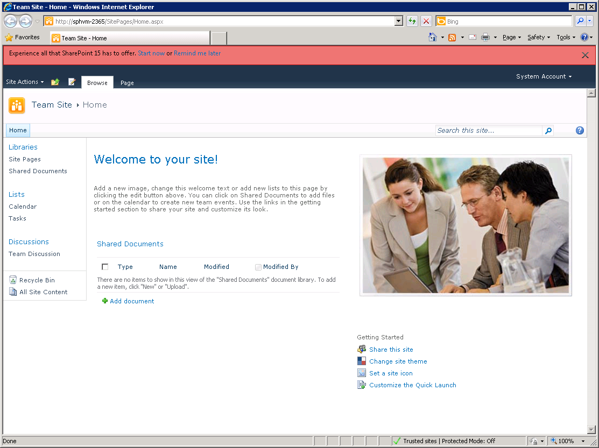
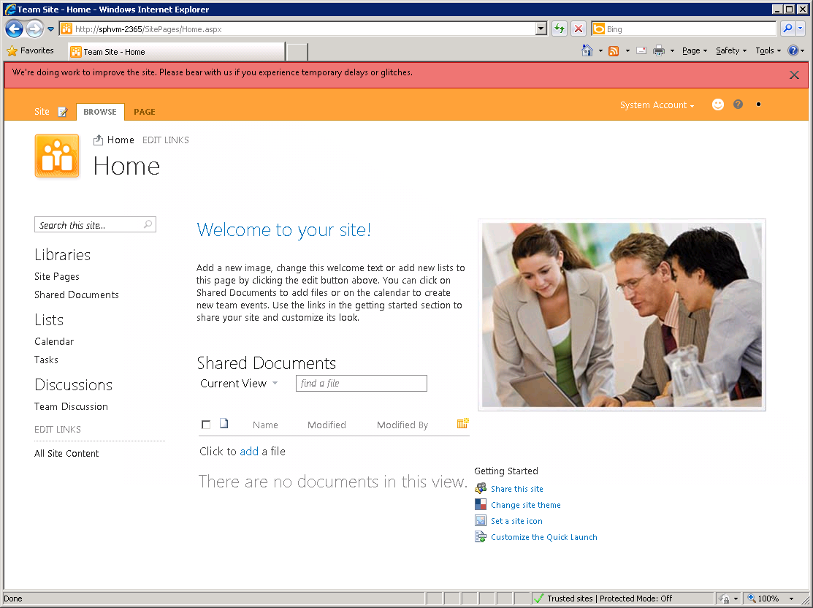
System Status Bar Notification Examples

Slide 20
Upgrade Logging
Changed to ULS format
TSV format allows improved parsing
Can be imported into Excel
Includes Correlation ID
Per SPSite logs available to Site Collection admins
Uses separate logging level control than rest of upgrade
Shows reduced set of information by default
Created for both B2B and V2V upgrades
Stored as content within Site Collection
Maintenance Logs library created as Gallery
Maintenance Logs secured to Site Collection Admins only
Hidden feature activates during first upgrade

Slide 21
Site Collection Upgrade Throttling
Prevents overload from self-service site collection upgrade
Throttles are used to allow/limit upgrade
Built-in throttles work together:
Application pool level throttle
Limits number of simultaneous upgrades per application pool instance
Default is 5 concurrent site collection upgrades allowed per web app
Effectively becomes a per server level throttle for most environments
Web Application instance property controls this throttle
Content Database level throttle
Limits number of simultaneous upgrades per content database instance
Default is 10 concurrent site collection upgrades allowed per content database
Content Database instance property controls this throttle
Content throttle
Prevents self service upgrade within application pool process for oversize sites
Default is site collection < 10MB and has <10 subwebs
Web Application instance property controls this throttle
If an upgrade is not possible due to throttling it is queued
Queued upgrades are processed by the timer service by upgrade timer job

Slide 22
Federated Services Compatibility Cross Versions
SP2013 federated services support 2010 consumers
Only federated services supported this:
Search
Profile
Social
Secure Store
Managed Metadata
BCS
Allows parallel service farms
2010 services farm can be used while verifying upgrade of federated services
SP2013 farm can be used once
SP2013 farm should be first farm upgraded as best practice
2010 non-federated services remain used by 2010 farm only

Slide 23
Learn Upgrade
Deferred Site Collection Upgrade Internals

Slide 24
Site Collection Modes
14 Mode
15 Mode
Uses legacy 14 mode JS and CSS
Uses legacy _layouts and _controltemplates directories
Uses existing 14 features, web parts, and site definitions
No 2013 features can be enabled/activated on a 14 mode site
Existing 2010 (and earlier) solutions can be deployed to 14 directories
New 2013 solutions are not deployed to 14 directories by default
Uses new 15 mode JS and CSS
Uses new _layouts\15 and _controltemplates\15 directories
Mainly uses new 15 features and web parts
Can use existing 14 features and web parts
Can only use 15 directory installed site definitions
Existing 2010 (and earlier) solutions can be deployed to 15 directories
New 2013 solutions are only deployed to 15 directories by default

Slide 25
Getting In The Mode
All existing site collections are in 14 mode
When performing database version upgrade
Only possible to force all sites to 15 mode using PowerShell
Not recommended just after database attach though, for perf and experience
Get-SPSite | Upgrade-SPSite -VersionUpgrade
New site collections can be created in 14 or 15 mode
Always available to farm administrators
Available by self-service site creation
Only if CompatibilityRange value on web application or tenant is set to allow it
Existing 14 mode site collections can be upgraded to 15 mode
Always available to farm administrators
Available by self-service site collection upgrade within UI
Only if CompatibilityRange and SPSite.AllowSelfServiceUpgrade values set to allow it
Only for site collection admins

Slide 26
CompatibilityRange
Used to determine:
If new site collections can be created in 14 or 15 mode
If existing site collections can be upgraded
Values:
“OldVersions”, “Old” or 14
Only new 14 mode SPSites can be created
No self-service upgrade enabled
“AllVersions”, “All”, or “14,15”
Both 14 and 15 SPSites can be created
Self-service upgrade is enabled
“NewVersion”, “New”, or 15
Only new 15 mode SPSites can be created
Self-service upgrade is enabled
WebApplication. CompatibilityRange
Acts as global value unless overridden at tenant level
Defaults to AllVersions
SPSiteSubscription CompatibilityRange values
Used by SPO to control upgrade
Both farm admin level and tenant admin level control values
Defaults to not being set to any value
Upgrade control can be overridden at SPSite level
SPSite.AllowSelfServiceUpgrade

Slide 27
Page Rendering Coexistence
14
Mode
Site Page
15
Mode
Site Page
SP2013 App Process Space
In-process request routing
Page
Code
Code
Page
/_layouts/
/_layouts/15/
WSE/14/Templates/Layouts
WSE/15/Templates/Layouts
14
Assembly
Redirect
Policy
15
Assembly
WSE/14/Templates
SP2013
Config
Database
WSE/15/Templates
SPSite
SP2013 Content
Database
SPSite
SPWeb
SPWeb

Slide 28
Versioned Site Storage and Feature/Templates
SP2013 Content Database
SPSite
SPSite
SPSite
Version=14
URL=/sites/foo
SPSite
Version=15
URL=/sites/bar
SPWeb
SPWeb
SPWeb
SPWeb
Feature
Feature
Feature
Feature
Feature
Feature
Feature
Feature
Feature
Feature
WSE\14\Templates
WSE\14\Templates
WSE\15\Templates
Site Definition
WSE\15\Templates
Site Definition
Site Definition
Site Definition
Feature Definition
Feature Definition
Template STS#1
Feature Definition
Template STS#1
Feature Definition
Feature Definition
Feature Definition
Template STS#2
Feature Definition
Template STS#2
Feature Definition
Feature Definition
Feature Definition

Slide 29
Feature Fallback Behavior
15 Mode Features List
15 Mode Lookups
SP2013 feature replacing SP14 feature
New SP2013 only feature
“Sunset” feature Visible=false
14 Mode Features List
14 Mode Lookups
SP14 feature replaced by SP2013 feature
Non-replaced O14 only feature (e.g. 3rd party)
SP14 feature removed in SP2013

Slide 30
Unsupported In 14 Mode
All new SharePoint 2013 specific features
Must upgrade the SPSite to 15 mode first
2010 Web Analytics
Existing features must be removed
New web analytics features supported only in 15 mode
2010 Office Web Applications (WAC)
Replaced with 2013 Office Web Applications for both 14 and 15 mode
PowerPoint Broadcast sites must be removed
No replacement available, use Lync instead
Project Web Access Sites (PWA Template)
Must upgrade to 15 mode to use
Project Sites (PWS) supported in both 14 and 15 mode

Slide 31
Using Self-Service Site Collection Upgrade
Demo

Slide 32
Learn Upgrade
Database/Service Changes

Slide 33
Database Changes
Security improvements
New application roles on all databases
Replaces requiring DB_Owner role for normal use
DB_Owner or equivalent rights still required to perform database upgrades
Running accounts no longer have schema modification rights
Runtime content database optimizations
Sparse column support allows wider lists
This results in a longer running database upgrade action depending on source data
Shredded store to support file edits
This results in a longer running database upgrade action depending on source data
Upgrade depth improvements
Upgrade of content database schema is separated from site collection upgrade
Allows faster database upgrade performance

Slide 34
Upgrading Services
Office Web Apps 2013 is now on separate farm
Consumable only by SP2013 farms
New WOPI protocol support only exists starting with SP2013
Works in both 14 and 15 mode for Site Collections
New WAC functionality for editing documents shows up in 14 mode
User Defined Functions no longer work in Excel Services
This is due to changes around how WAC is designed

Slide 35
Learn Upgrade
Downtime Mitigation

Slide 36
Read Only Mode Support
Services support read-only database state
Access databases are sole exception to this
Site Collection level notification of read-only state
System status bar message
Improvements separate maintenance from locks
SPSite.ReadOnly – Farm Admin controlled
SPSite.MaintenanceMode – Dynamic control via internal system processes
SPSite.Archived – Site Collection Admin & Farm Admin controlled

Slide 37
Learn Upgrade
Conclusion
Notes:
Upgrade Requirements
Upgrade Methods/Supported Upgrade Paths
Upgrade Improvements
Deferred Site Collection Upgrade Internals
Database/Service Changes
Downtime Mitigation

Slide 38
Q&A

Slide 39

© 2012 Microsoft Corporation. All rights reserved. Microsoft, Windows, Windows Vista and other product names are or may be registered trademarks and/or trademarks in the U.S. and/or other countries.
The information herein is for informational purposes only and represents the current view of Microsoft Corporation as of the date of this presentation. Because Microsoft must respond to changing market conditions, it should not be interpreted to be a commitment on the part of Microsoft, and Microsoft cannot guarantee the accuracy of any information provided after the date of this presentation. MICROSOFT MAKES NO WARRANTIES, EXPRESS, IMPLIED OR STATUTORY, AS TO THE INFORMATION IN THIS PRESENTATION.

